Slide 1


Google Machine Learning courses
Notes:
https://developers.google.com/machine-learning/crash-course

Slide 2
What you will learn
Linear Regression
Logistic Regression
Classification
Working with Numerical Data
Working with Categorical Data
Datasets, Generalization, and Overfitting
Neural Networks
Embeddings
Large Language Models
Production ML Systems
AutoML
ML Fairness

Slide 3
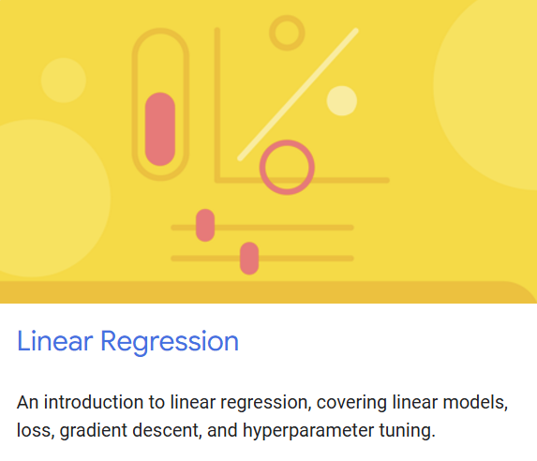
Linear regression
Notes:
https://developers.google.com/machine-learning/crash-course/linear-regression

Slide 4
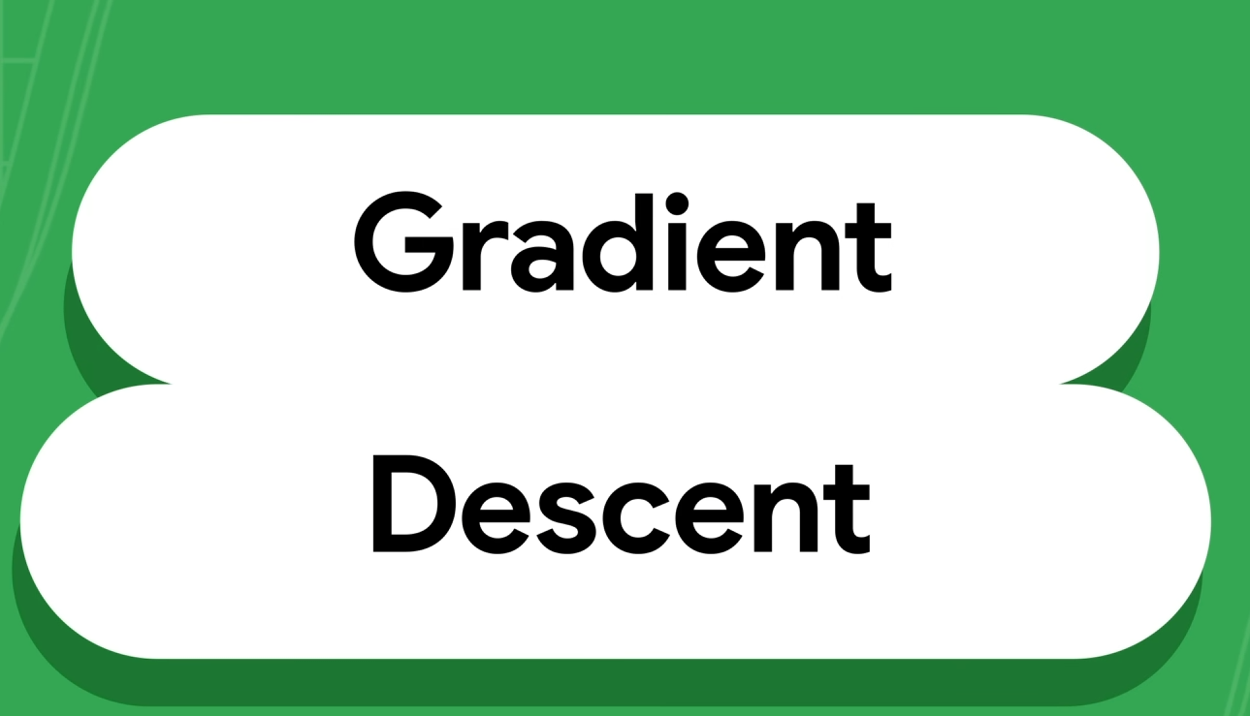

Slide 5
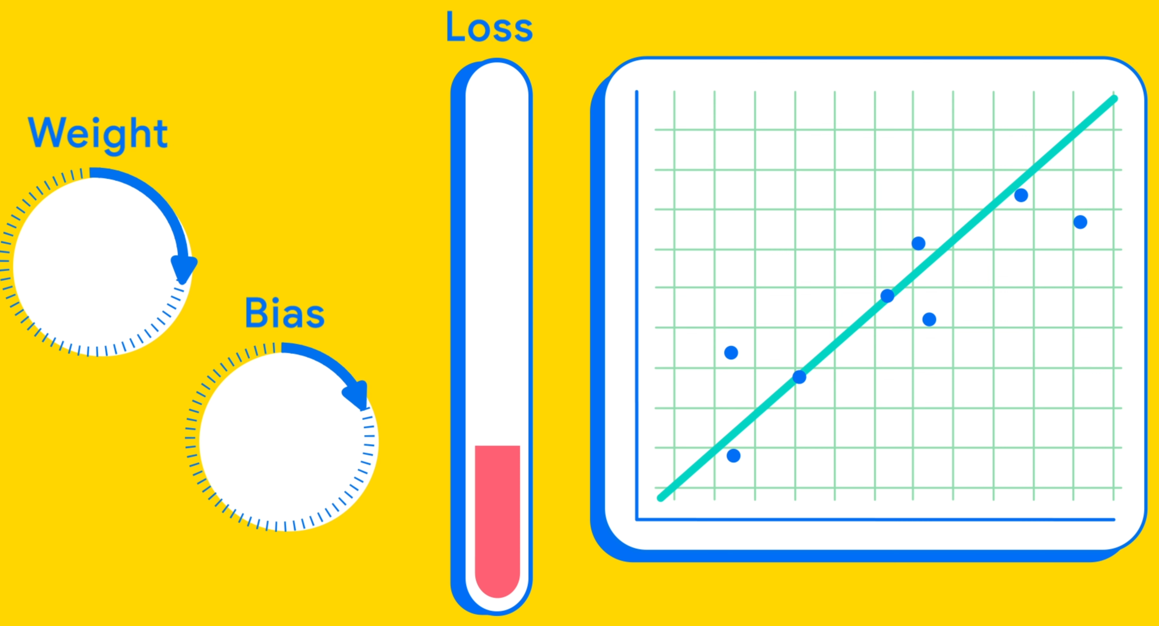

Slide 6
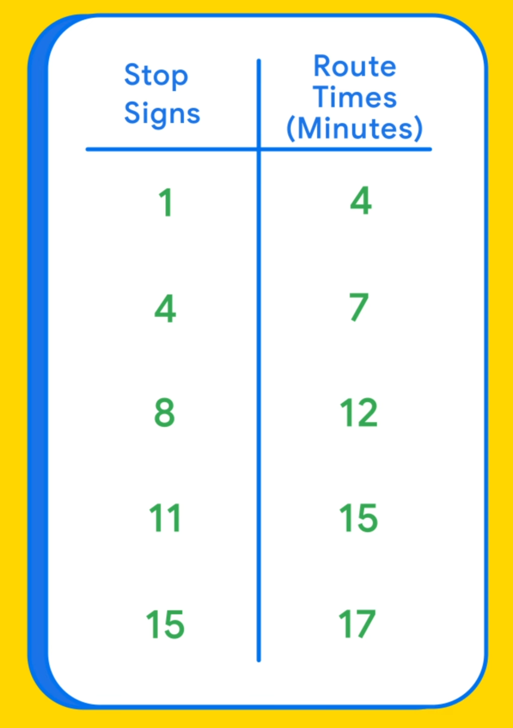

Slide 7
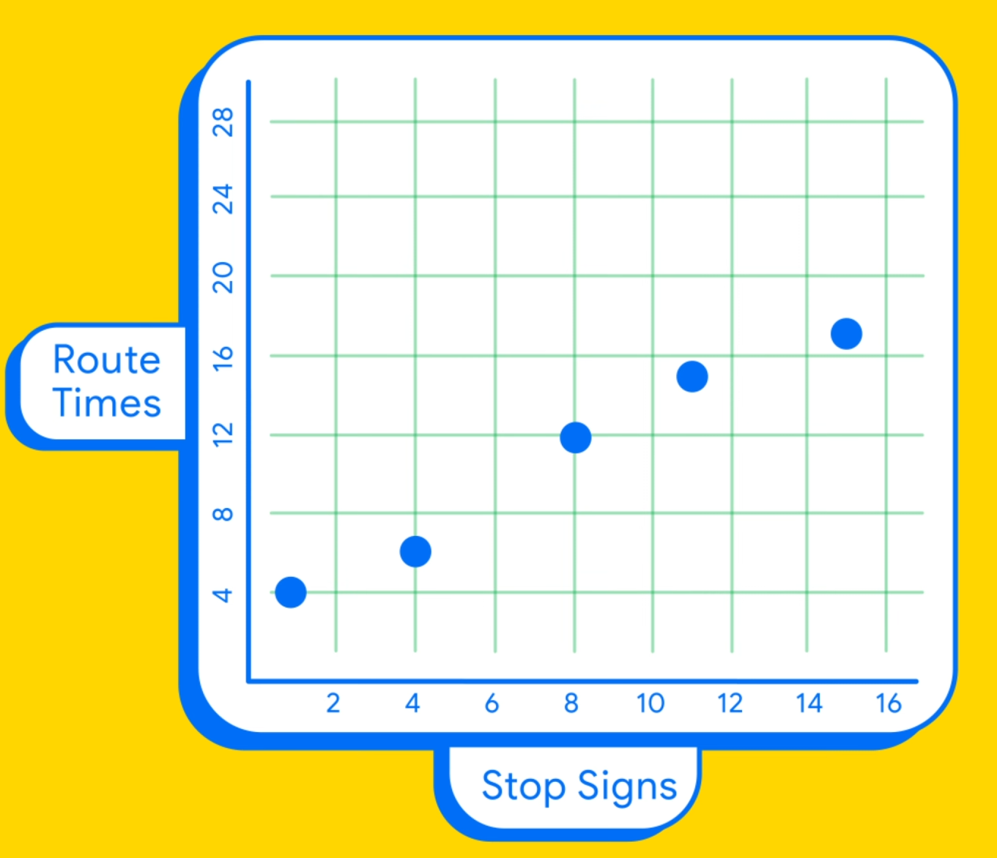

Slide 8
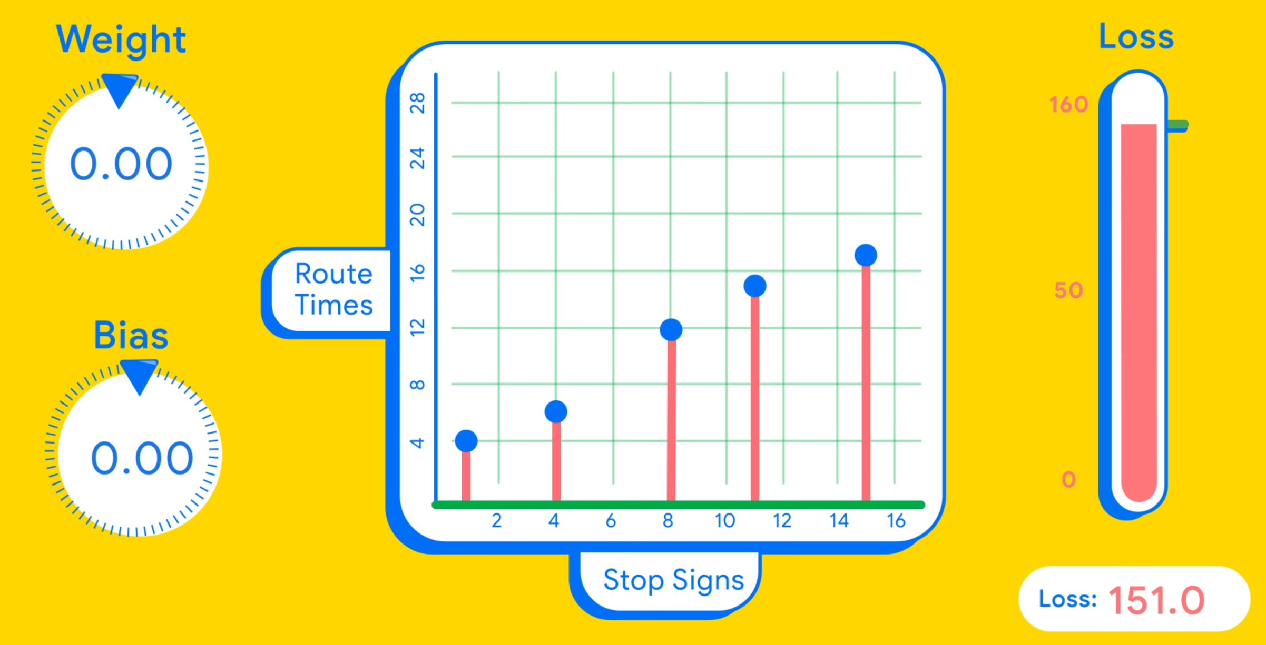

Slide 9
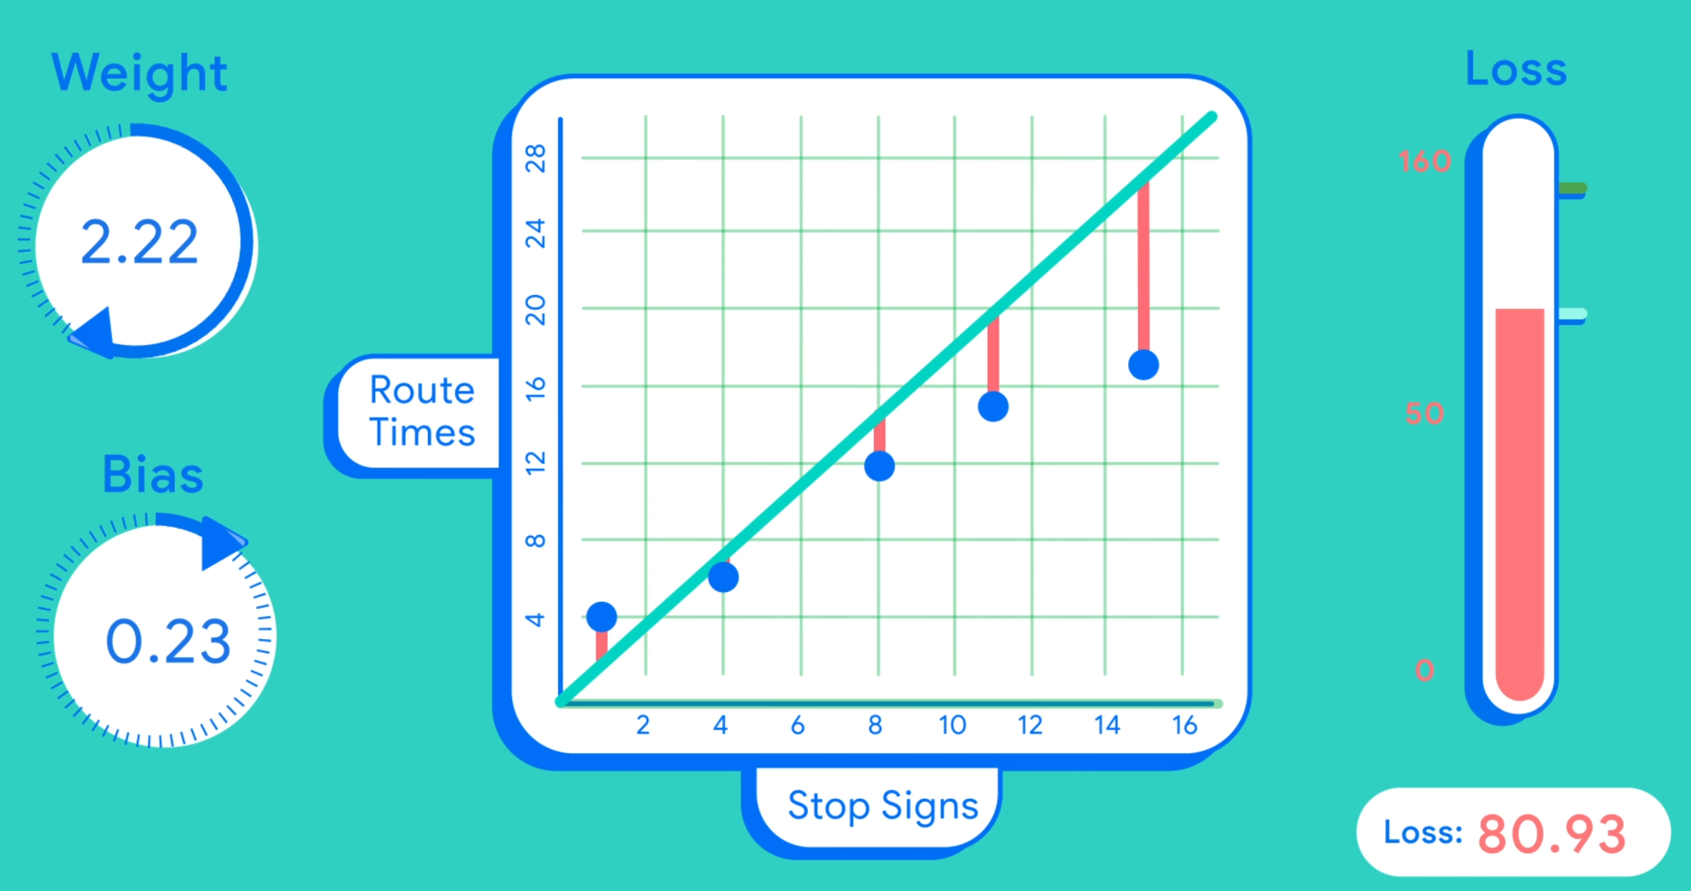

Slide 10
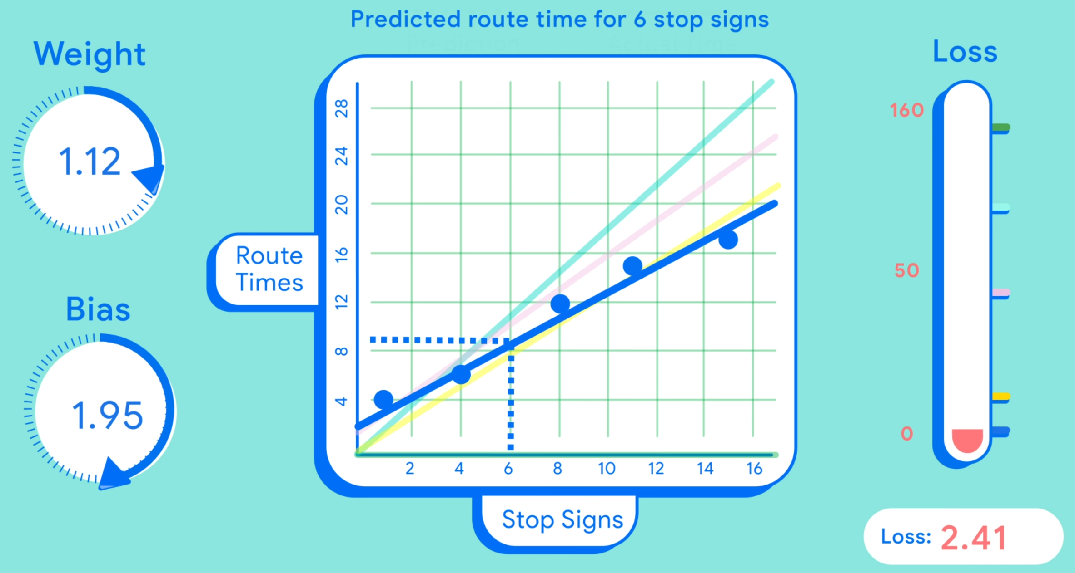

Slide 11
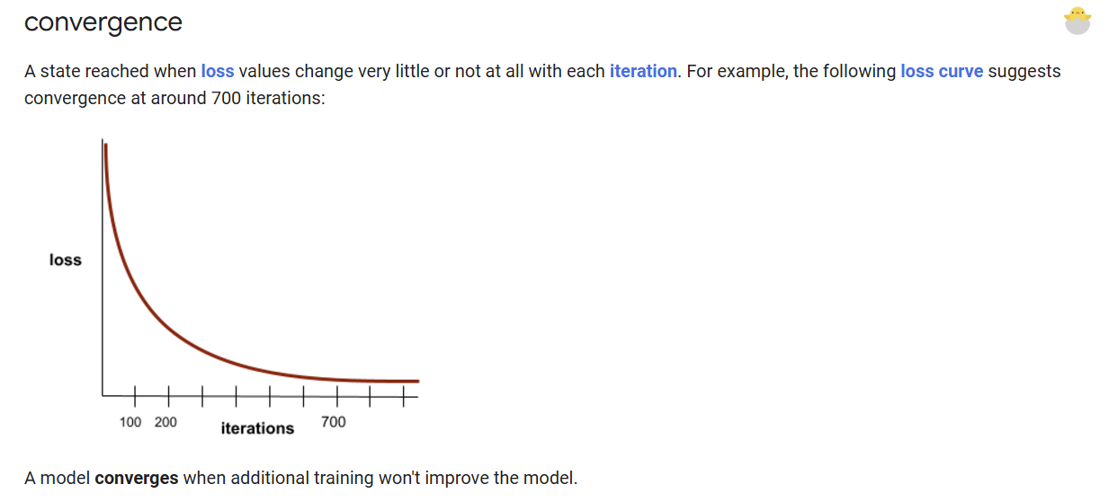

Slide 12
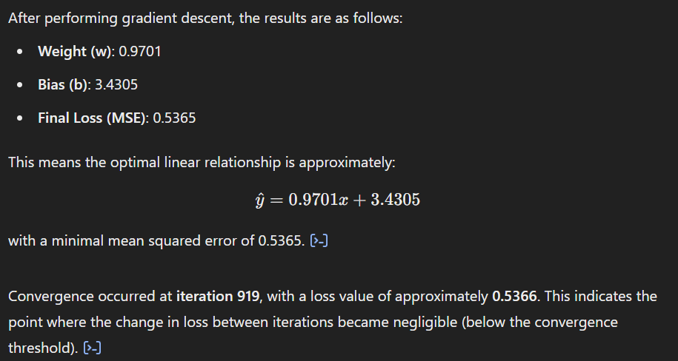

Slide 13




Notes:
https://www.youtube.com/channel/UC35ZpwldGw7ZJ5R-2sLijzw

Slide 14
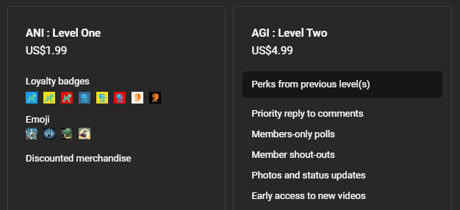
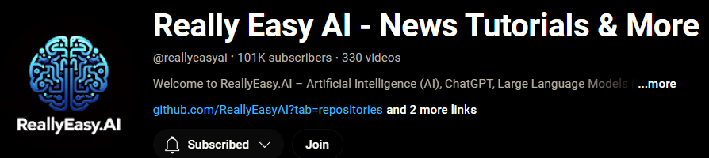
Membership has its privileges
Notes:
https://www.youtube.com/channel/UC35ZpwldGw7ZJ5R-2sLijzw/join

Slide 15

https://www.youtube.com/@AINewsFresh

Slide 16

https://www.youtube.com/@DailyAINewsPodcast

Slide 17

https://www.youtube.com/@AIPapersPodcastDaily

Slide 18
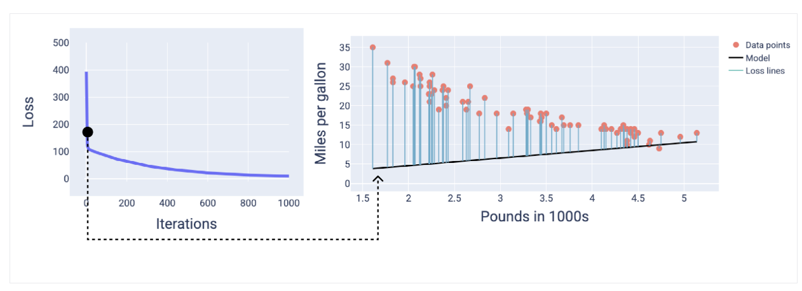

Slide 19
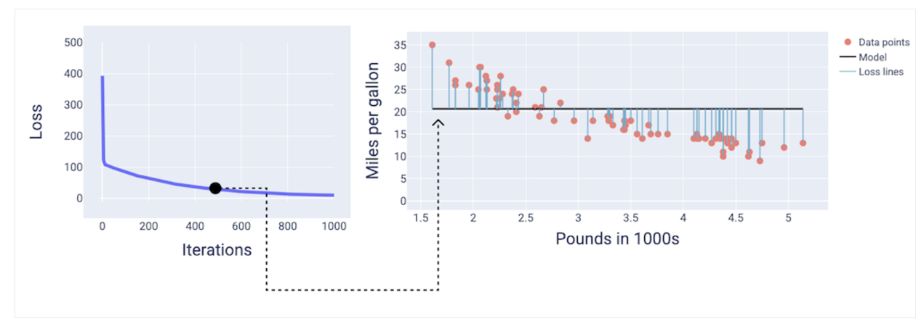

Slide 20
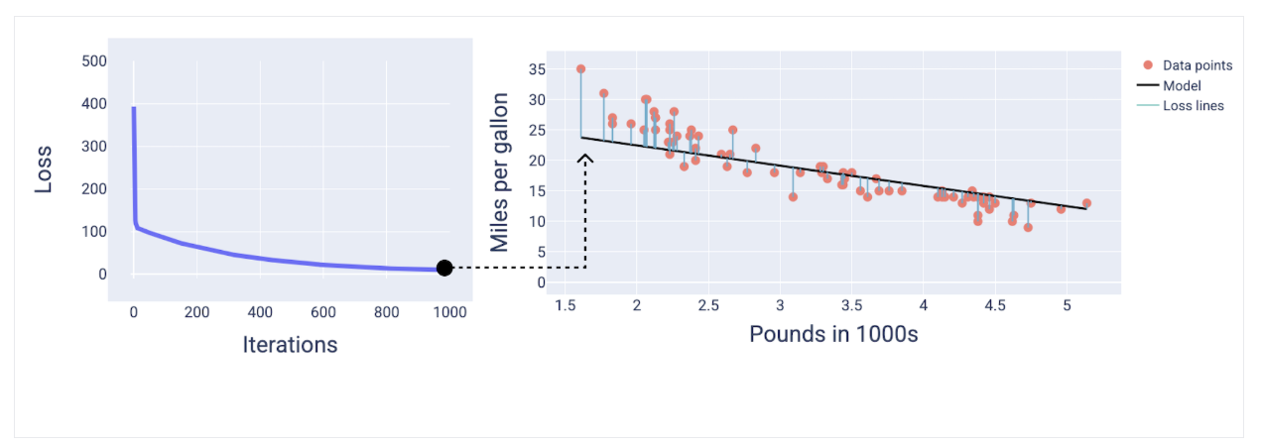

Slide 21
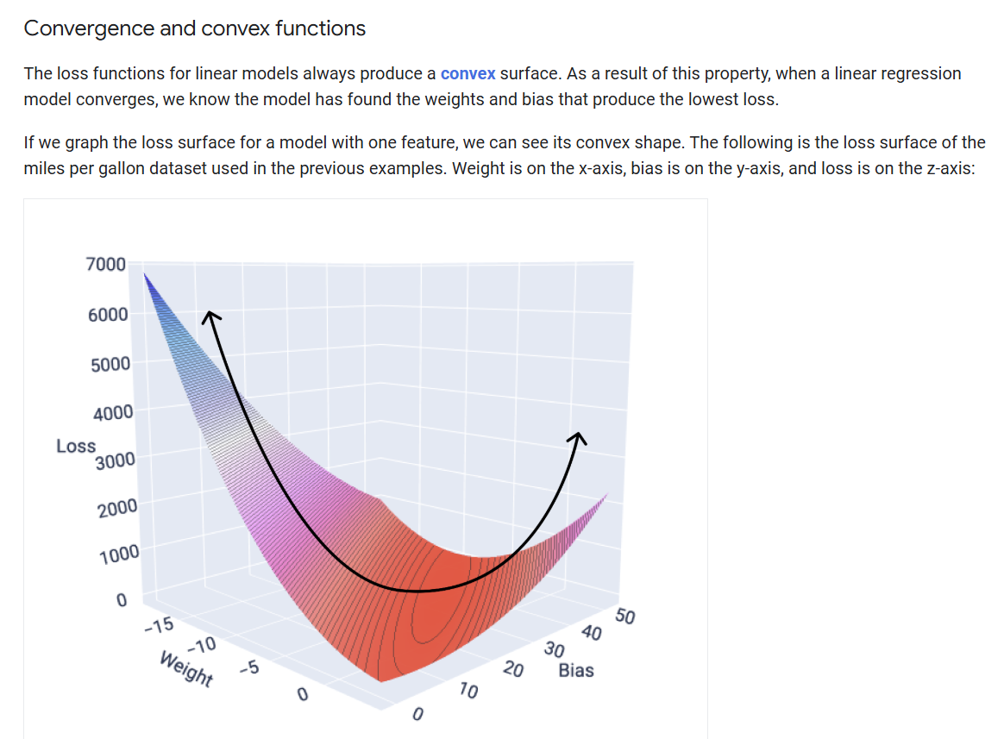

Slide 22
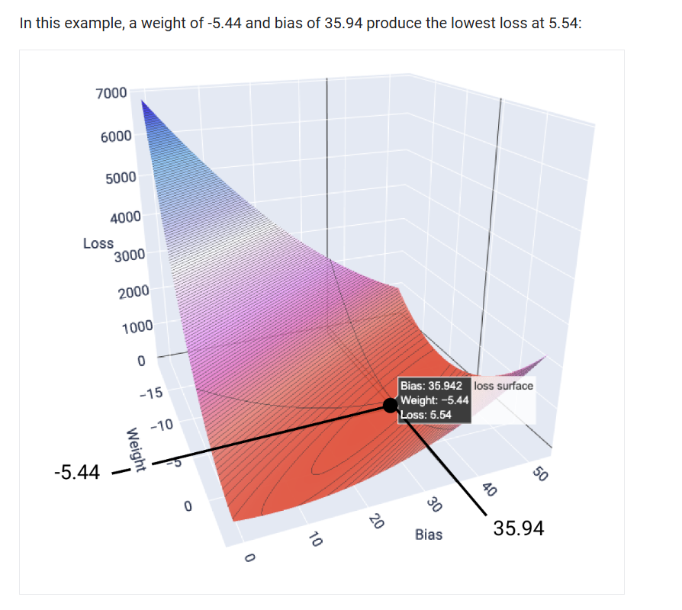

Slide 23
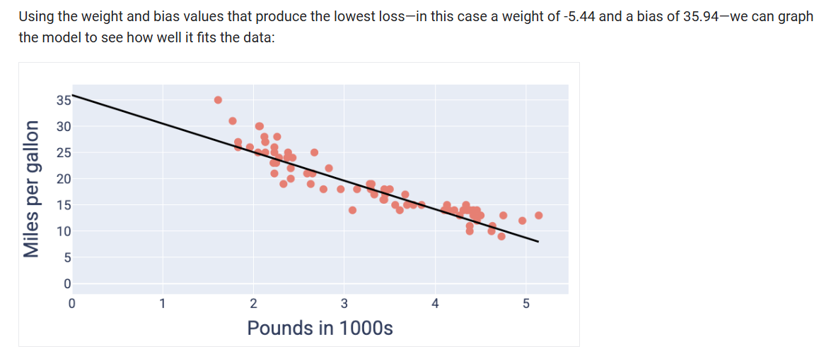

Slide 24
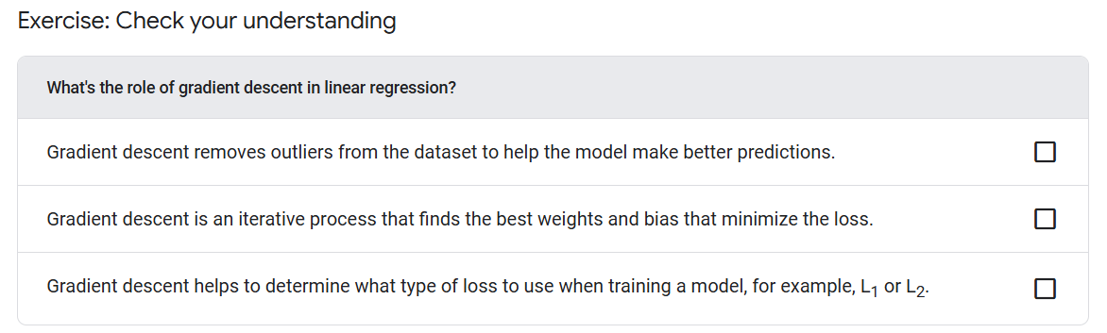

Slide 25
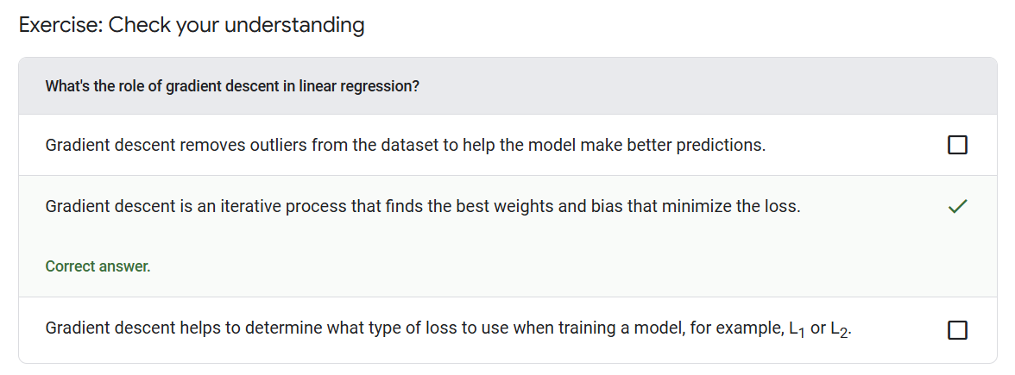

Slide 26
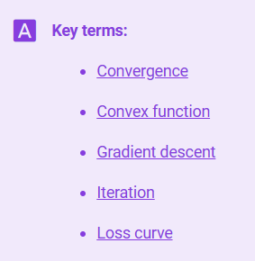
Notes:
https://developers.google.com/machine-learning/glossary

Slide 27


